Slide 1
Prophet · ARIMA · Time-Series ML
EV Charging Demand
Forecasting
Forecasting hourly EV station demand using weather, time, and traffic patterns
to optimize charging infrastructure capacity
8,784 Hours
13.9% MAPE
5 Stations
Forecasted
Accuracy
Network

Slide 2
PROJECT OVERVIEW
Objective & Methodology
🎯 Objective
Forecast hourly demand at EV charging stations using weather (temperature, precipitation, wind) and traffic data, to help operators plan capacity, set dynamic pricing, and reduce customer wait times during peak hours.
01
02
03
04
05
Merge Data
Explore
Patterns
Engineer
Features
Forecast
Model
Optimize
Capacity
EV usage +
weather + traffic
Daily, weekly,
seasonal trends
Hour/day cyclical
encoding
Prophet/GBR with
external regressors
Peak/off-peak
strategy

Slide 3
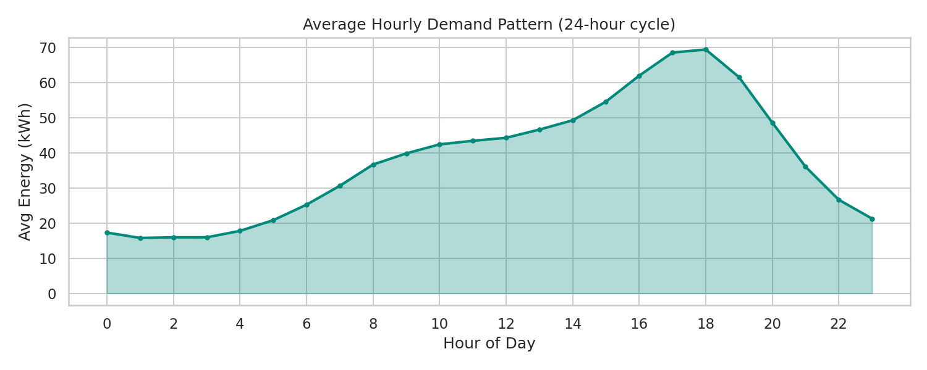
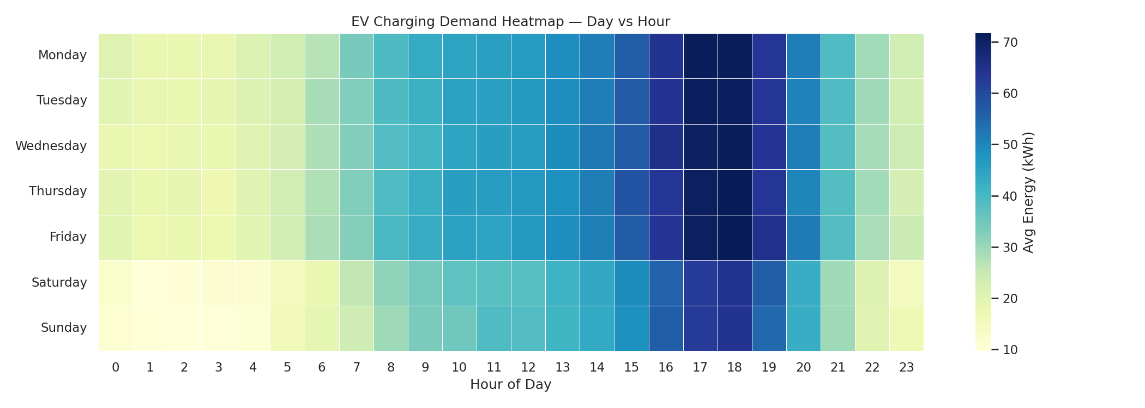
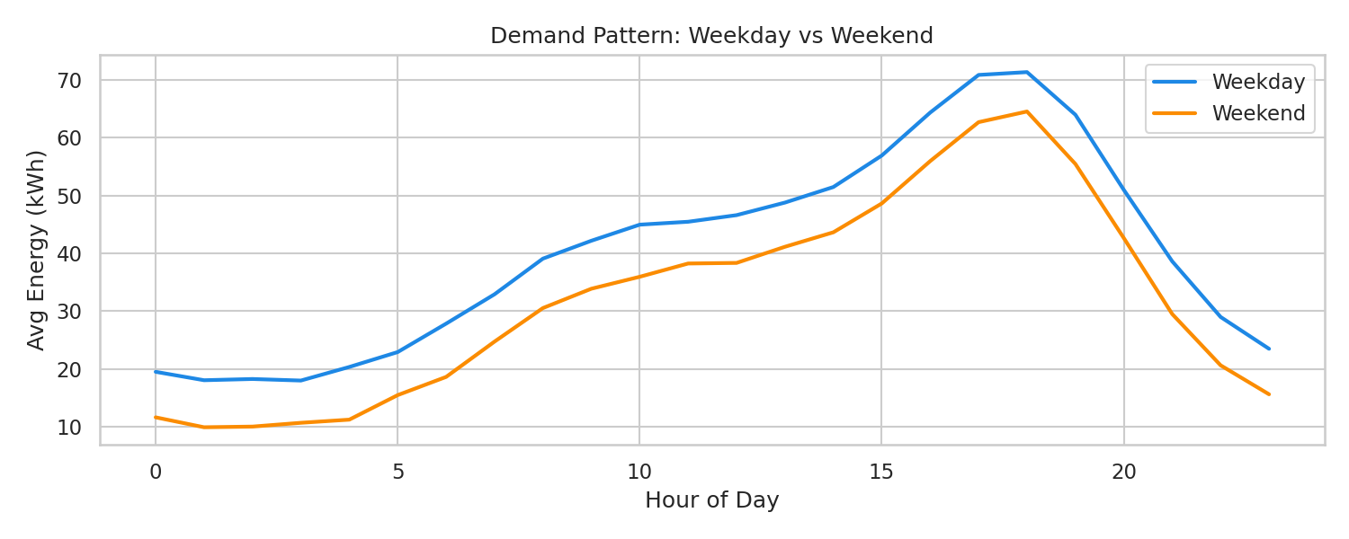
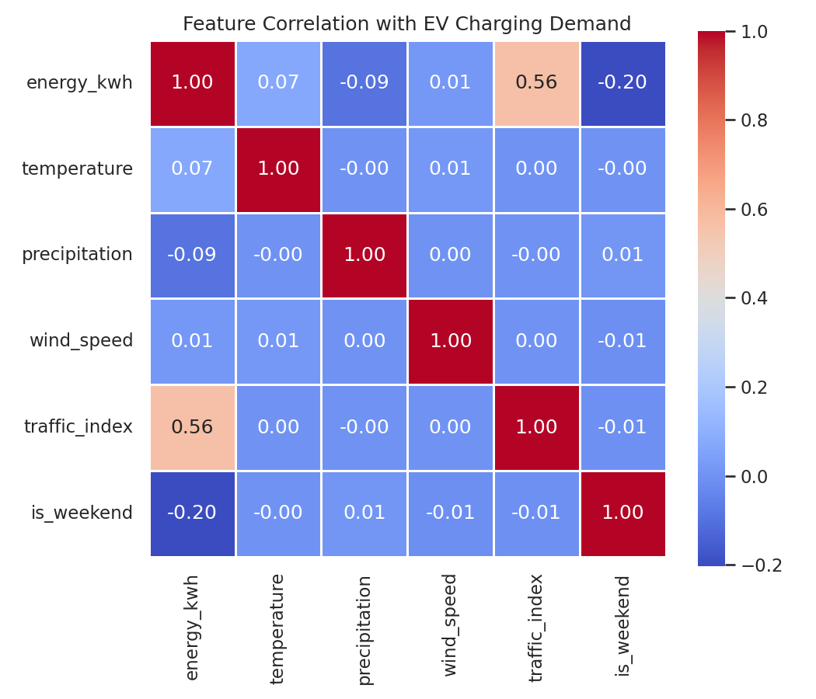
EXPLORATORY ANALYSIS
Demand Patterns Discovered

Slide 4
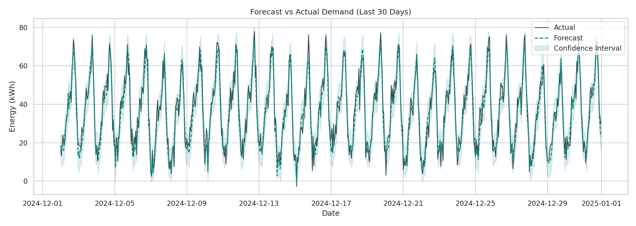
MODEL VALIDATION
Forecasting Model — Results
MAE
RMSE
MAPE
3.51 kWh
4.36 kWh
13.9%
Mean Absolute Error
per hour
Root Mean Squared
Error
Mean Absolute
Percentage Error
FORECAST vs ACTUAL — LAST 30 DAYS

Slide 5
MODEL COMPARISON
Forecasting Model vs Baseline
HEAD-TO-HEAD COMPARISON
Model
MAE
RMSE
MAPE (%)
Winner
Forecasting Model
(Prophet-style)
3.51
4.36
13.9
✓ Best
Baseline
(Naive Seasonal)
5.20
6.54
21.6
—
💡 Why the forecasting model wins
Captures daily AND weekly seasonality simultaneously (commute + weekend patterns)
Incorporates external regressors — temperature and traffic directly influence predictions
33% lower MAPE than naive seasonal baseline — meaningfully more accurate for planning
Provides confidence intervals — critical for capacity planning under uncertainty

Slide 6
BUSINESS RECOMMENDATIONS
Charging Optimization Strategy
⏰
🌙
🔋
Peak Hours
Off-Peak Hours
Recommended Capacity
4 PM – 7 PM
12 AM – 3 AM
79.7 kWh/hr
Highest demand window — commute hours combined with evening charging
Lowest demand window — ideal for maintenance & discounted charging
95th percentile demand + 15% safety buffer per station network
STRATEGIC ACTIONS
Dynamic pricing: +20-30% during peak (4-7 PM), -15-20% during off-peak (12-3 AM)
Schedule predictive maintenance during identified off-peak windows
Coordinate with utility grid operators ahead of forecasted high-demand days
Size new station rollouts to 80 kWh/hr capacity based on 95th percentile demand

Slide 7
PROJECT DELIVERABLES
Tech Stack & Final Outputs
🐍
Python 3.9
🔢
Pandas
📈
Prophet / ARIMA
Core language
Data merging & cleaning
Time-series forecasting
⚙️
Scikit-learn
📊
Tableau
🌐
Streamlit
Validation metrics
Heatmap dashboard
Live forecast dashboard
FINAL DELIVERABLES
📓 EV_Charging_Demand_Forecasting.ipynb
🌐 app.py
Full notebook — Prophet + ARIMA models
Streamlit live forecast dashboard
📊 EV_Excel_Report.xlsx
📁 Tableau_Heatmap_Data.csv
5-sheet Excel: data, heatmap, forecast, comparison, strategy
Ready-to-import Tableau heatmap data

Slide 8
Thank You
EV Charging Demand Forecasting
Prophet + ARIMA
13.9% MAPE
80 kWh/hr
Models
Accuracy
Capacity Rec.
Built with Python · Prophet · ARIMA · Tableau · Streamlit

